Slide 1
Research Computing Services
Unix Command Line
https://github.com/nuitrcs/intro-command-line-april-2019
Dusan Ramljak: dusan.ramljak@northwestern.edu
Christina Maimone: christina.maimone@northwestern.edu
Slides borrowed from Janna Nugent,
Alper Kinaci, and Christina Maimone

Slide 2
Background
At a high level, computers do four things:
run programs
store data
communicate with each other, and
interact with us

Slide 3
Bash
The Shell - a program which runs other programs
(rather than doing calculations itself)
The most popular Unix shell is Bash
The Bourne Again SHell
Derived from a shell written by Stephen Bourne
Bash is the default shell on
Unix
Linux
Packages providing Unix-like tools for Windows

Slide 4

Designed for ease of use:

Slide 5
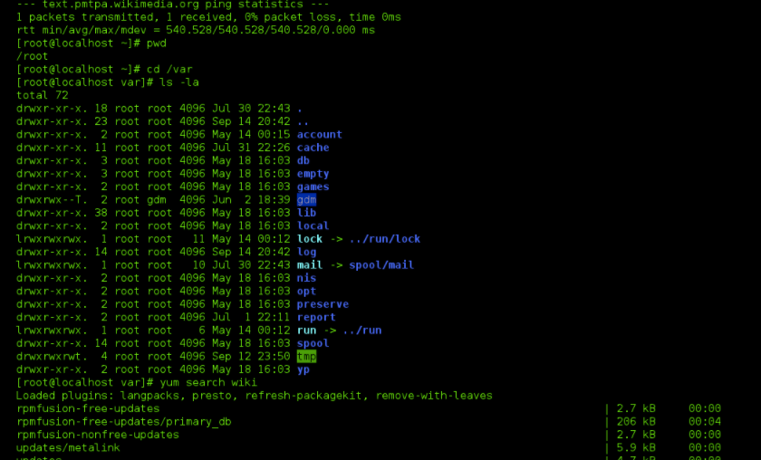

Designed for power
NOT
Designed for ease of use:

Slide 6
Where you will see it?
Older (way way older) computers
Linux
Unix
HPC
Remote servers

Slide 7
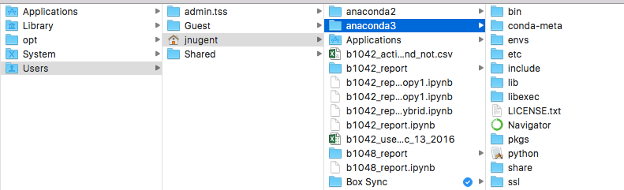
Finder on a Mac

Slide 8
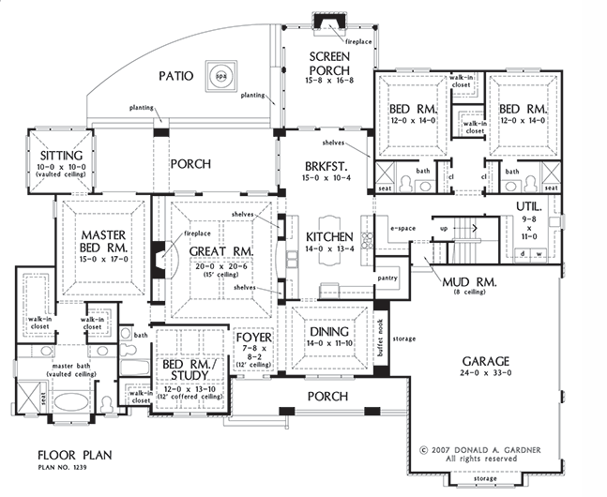
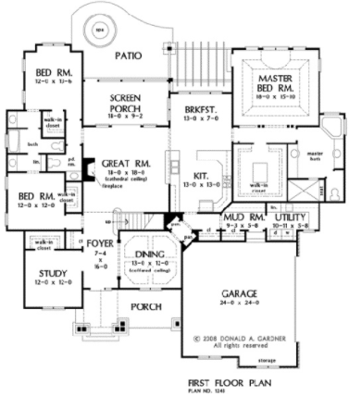
Finder on a Mac

Slide 9
looking around at files in Unix
$ pwd
/c/Users/dri9634/Desktop
$ ls
chunk_accesses/ data-shell.zip 'GitHub Desktop.lnk'* Python/
data-shell/ desktop.ini jupiterNotebooks/
$ cd data-shell
$ pwd
/c/Users/dri9634/Desktop/data-shell
$ ls
creatures/ data/ molecules/ north-pacific-gyre/ notes.txt pizza.cfg solar.pdf writing/

Slide 10
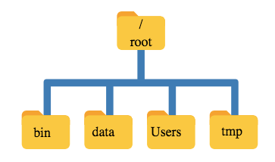

Slide 11


“Root”
a location: the base of the filesystem tree
/
a user: the superuser

Slide 12
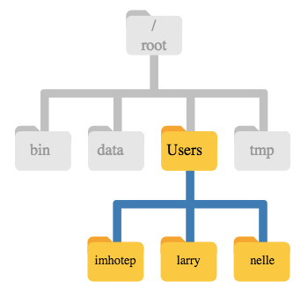

Slide 13
Finder on a Mac

Slide 14

Getting Started
Launch terminal
Let the fun begin!

Slide 15
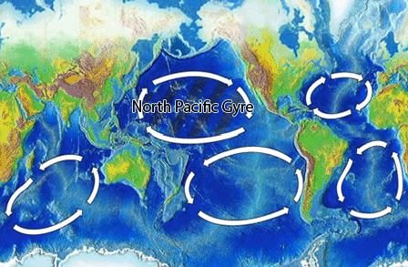
North Pacific Gyre
Great Pacific Garbage Patch

Slide 16
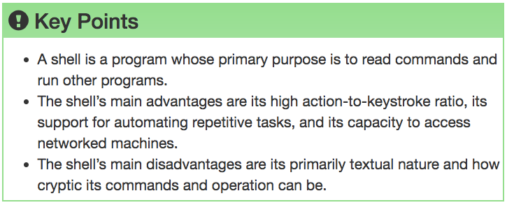

Slide 17

Navigating Files & Directories

Slide 18
Questions
How can I move around on my computer?
How can I see what files and directories I have?
How can I specify the location of a file or directory on my computer?

Slide 19
Objectives
Explain: file and directory similarities and differences
Translate: absolute path into a relative path and vice versa
Construct: absolute and relative paths that identify specific files and directories
Demonstrate: the use of tab completion and its advantages

Slide 21
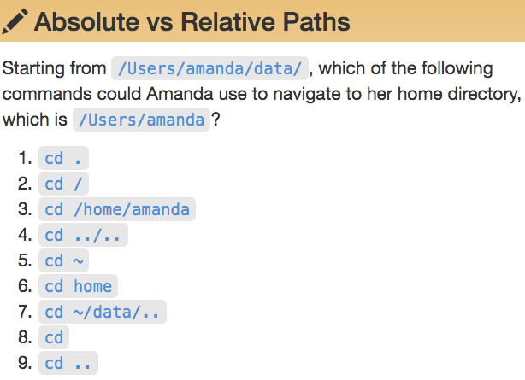
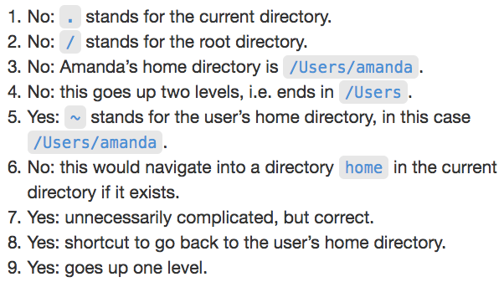


Slide 22
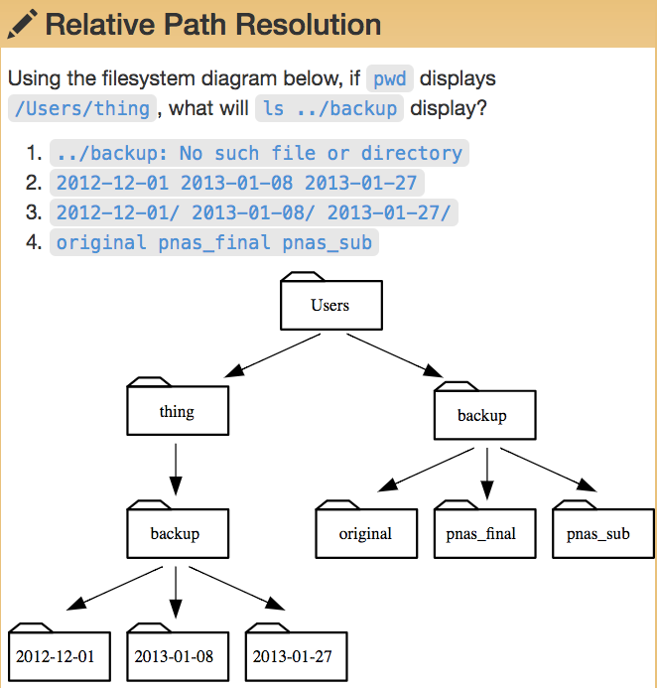

Slide 23
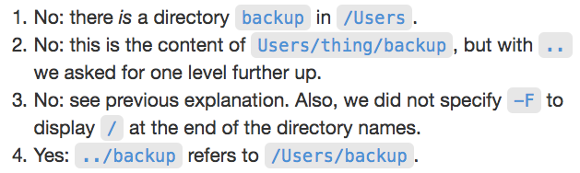
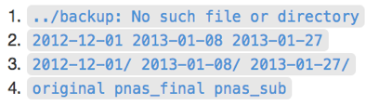

Slide 24
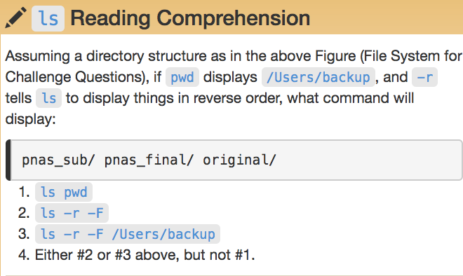
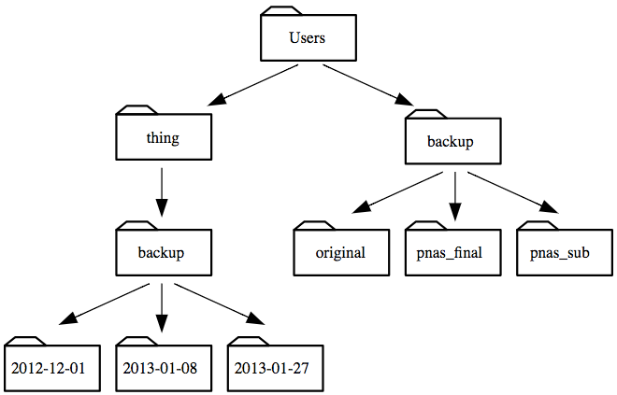

Slide 26
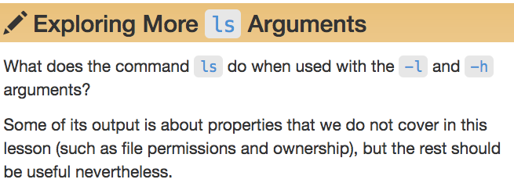
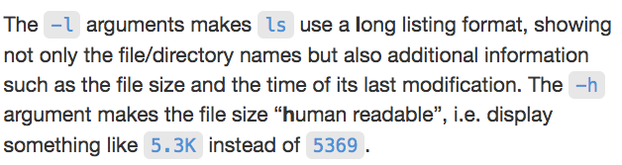

Slide 27
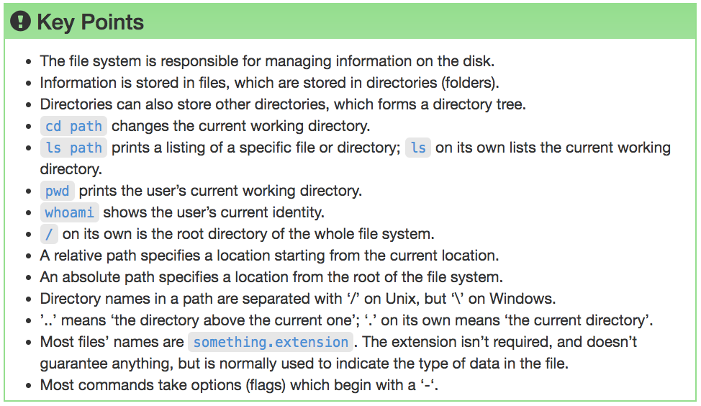

Slide 28
Working With Files & Directories

Slide 29
Questions
How can I create, copy, and delete files and directories?
How can I edit files?

Slide 30
Objectives
Create a directory hierarchy that matches a given diagram
Create files in that hierarchy using an editor or by copying and renaming existing files
Delete, copy and move specified files and/or directories

Slide 31
Good Names for Files & Directories
Don’t use whitespace (“my work”)
Don’t begin the name with a dash “-”
Don’t begin the name with a “.” unless you mean it
Use letters, numbers, “-”, “.”, “_”
If you need to use a filename with special characters,
surround the name in quotes (“- a bad name !”)

Slide 33
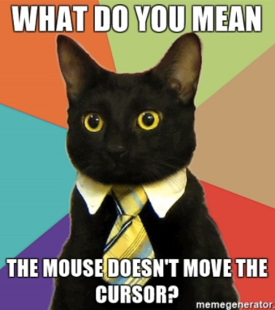
text editor: nano
type “nano <filename>” this will open the named file for editing or create it if it doesn’t exist
type your text: the mouse will not move the cursor - navigate with the arrow keys
save and quit: commands are on the bottom of the screen - the “^” stands for “control”

Slide 34
text editor: vi/vim
On command line: “vi test.txt”
You land in command mode
To enter insert mode: “i” where the cursor is; “o” inserts one line below that
Navigate with arrow keys
To exit insert mode: “esc”
To save: “:w”
To exit: “:q”
To exit without saving: “q!”

Slide 36
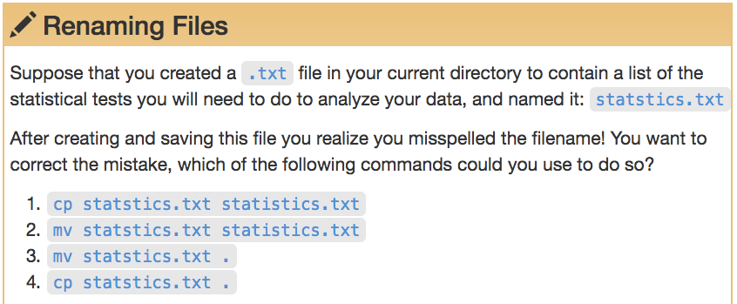
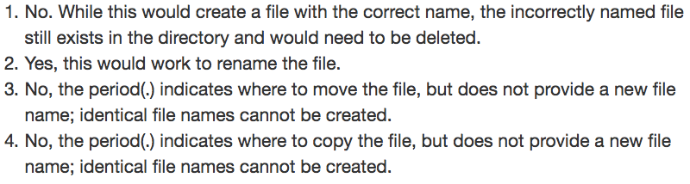

Slide 37
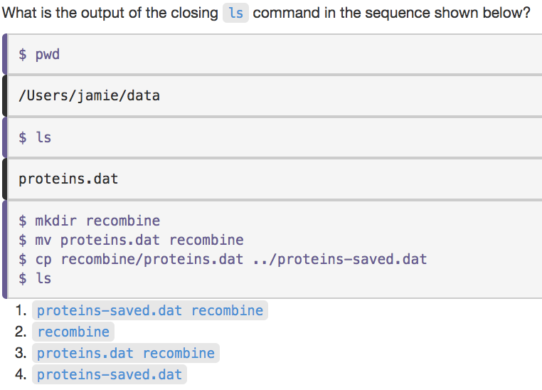

Slide 38
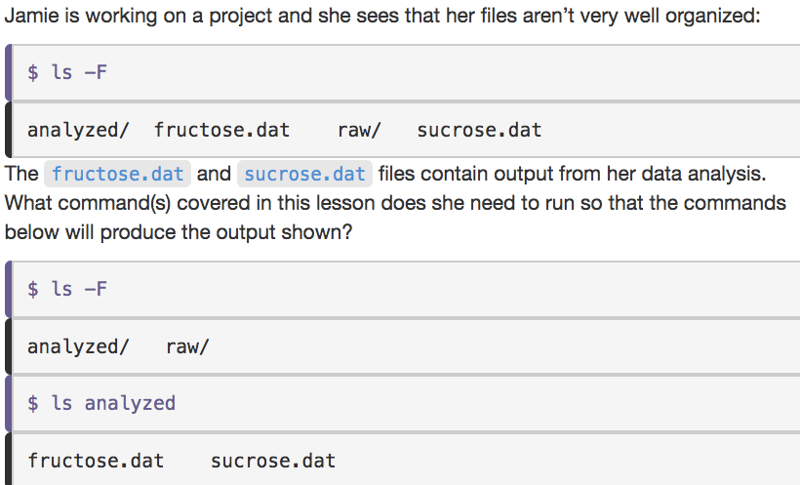

Slide 39
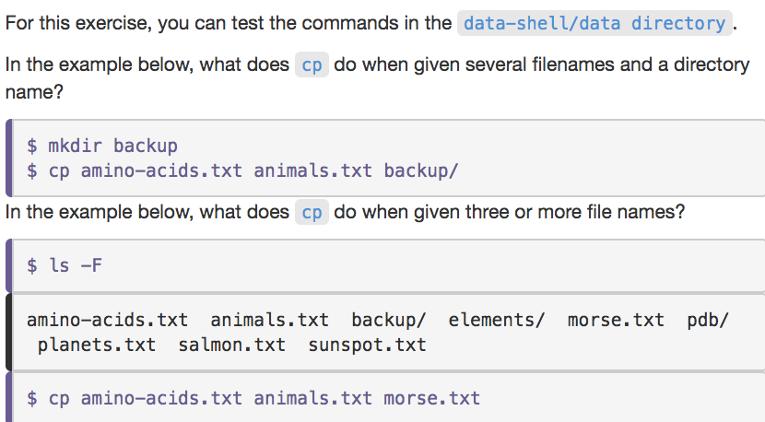
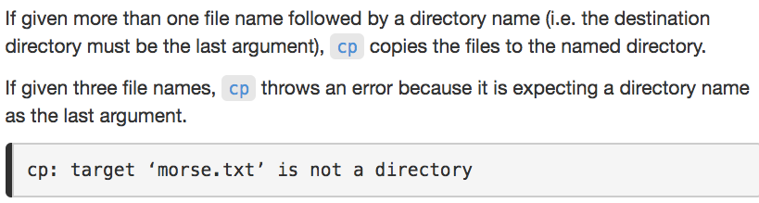

Slide 40
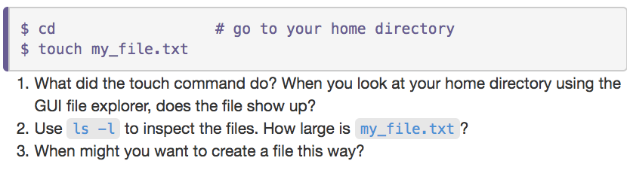

Slide 41
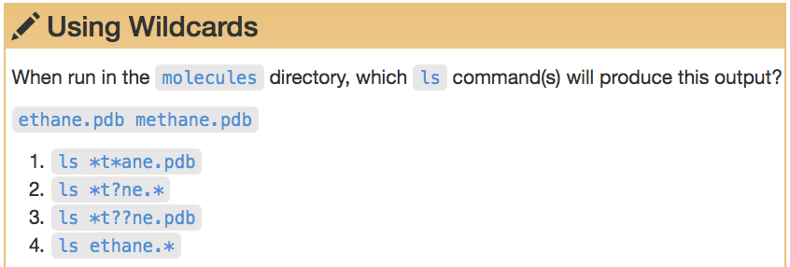
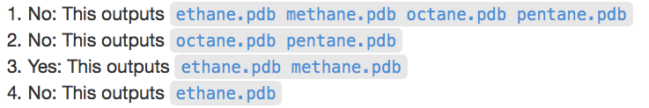

Slide 42
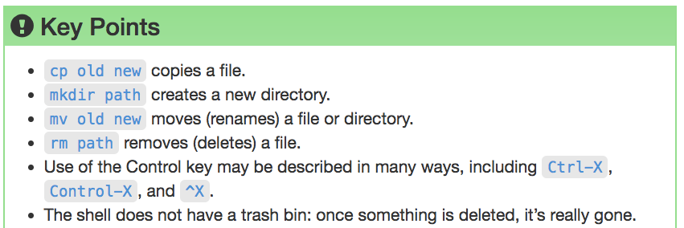

Slide 43
Pipes & Filters

Slide 44
Questions
How can I combine existing commands to do new things?

Slide 45
Objectives
Redirect a command's output to a file
Process a file instead of keyboard input using redirection
Construct command pipelines with two or more stages
Explain what usually happens if a program or pipeline isn't given any input to process
Explain Unix's 'small pieces, loosely joined' philosophy

Slide 47
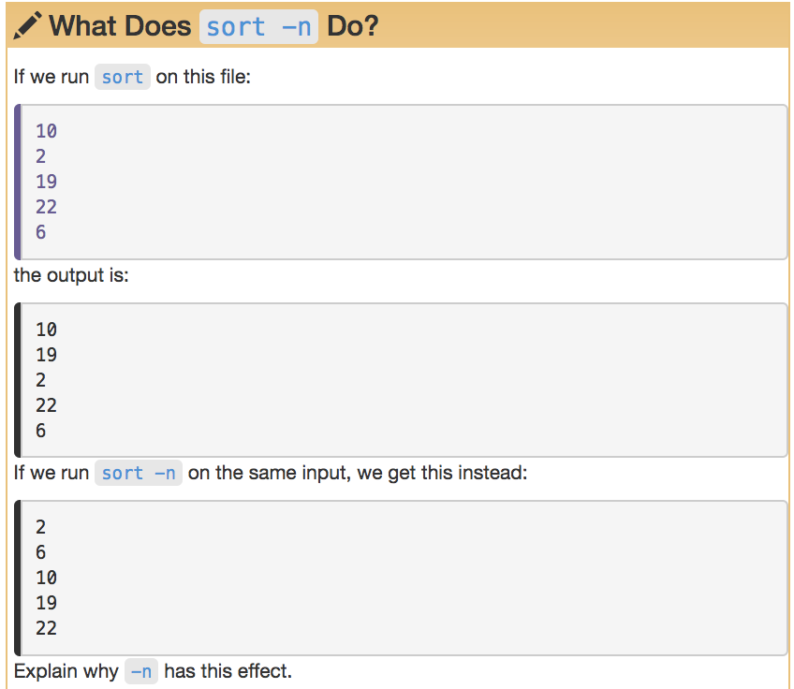

Slide 49
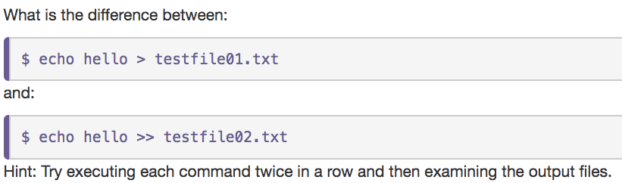

Slide 51
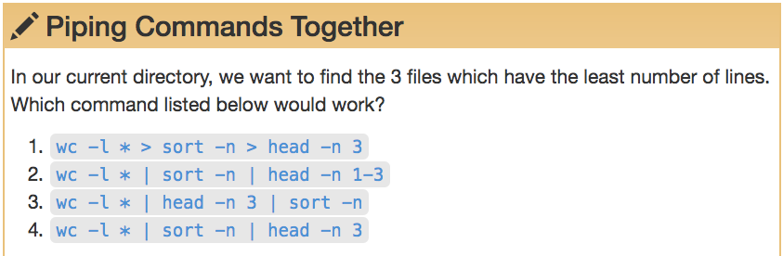
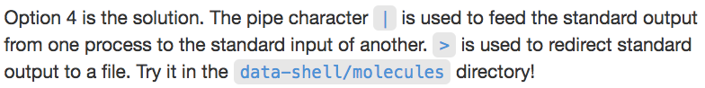

Slide 52
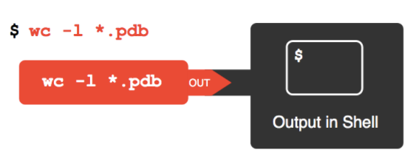

Slide 53
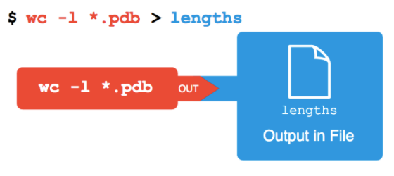

Slide 54
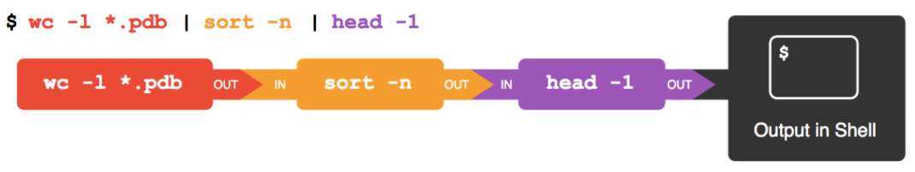

Slide 55
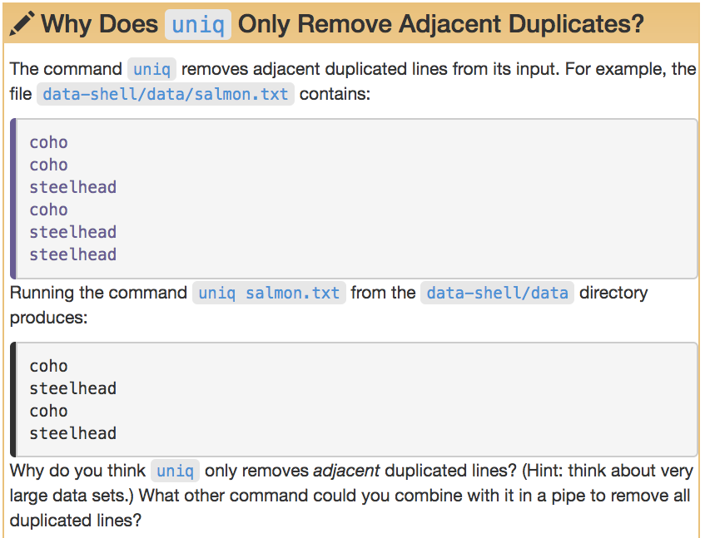

Slide 56
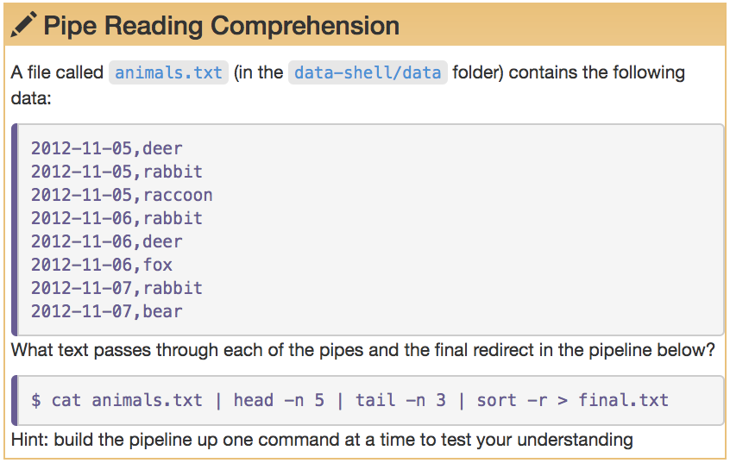

Slide 57
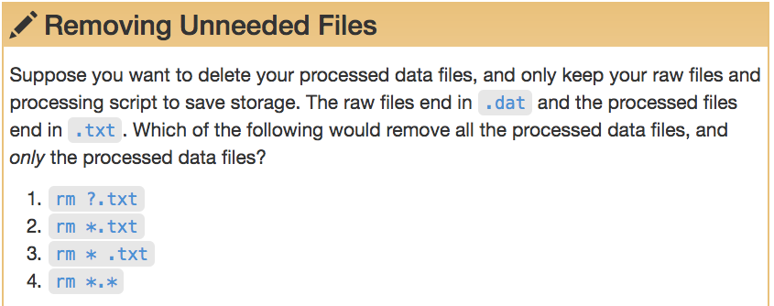

Slide 58
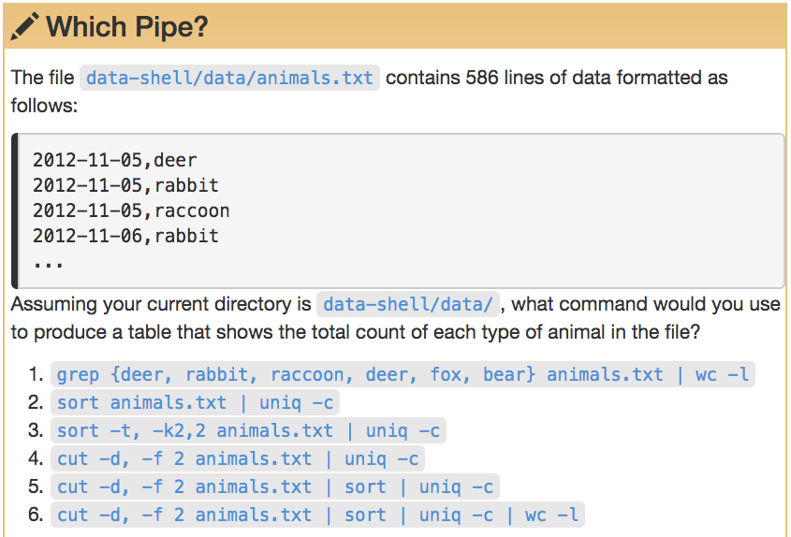

Slide 59
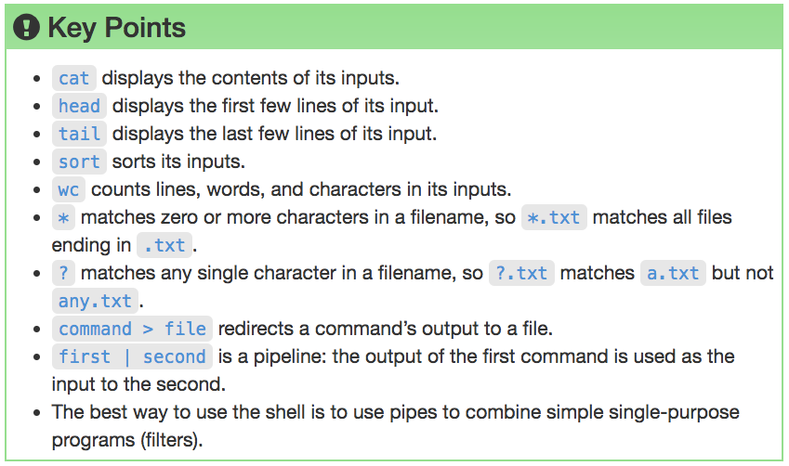

Slide 60
Finding Things

Slide 61
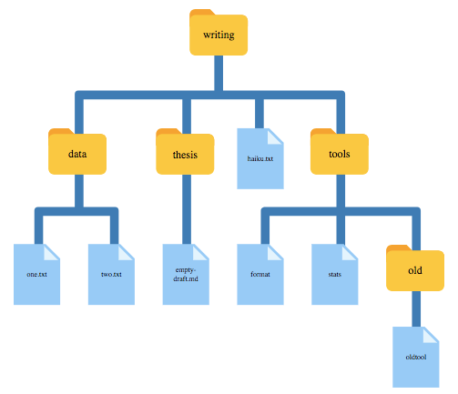

Slide 62
Find
finding files
Allows for elaborate searching on properties as size, access time, permissions
Handles dashes
Handles special characters such as spaces and newlines
Could be searched in parallel
print0 and 0 option allows file names that contain newlines or other types of white space to be correctly interpreted

Slide 63
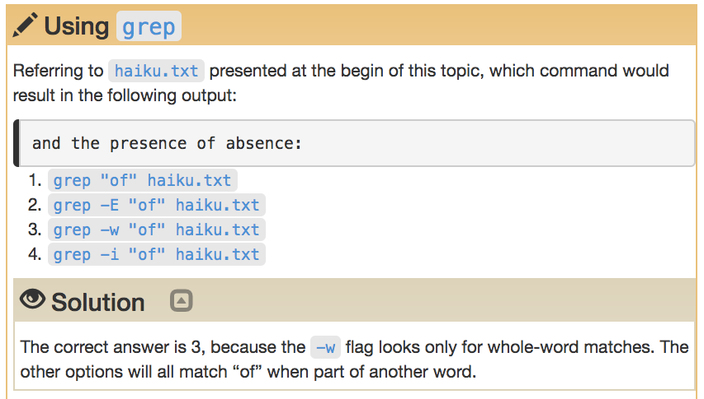

Slide 64
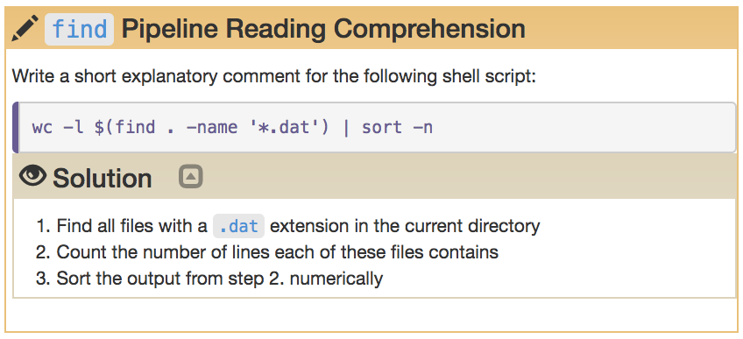

Slide 65
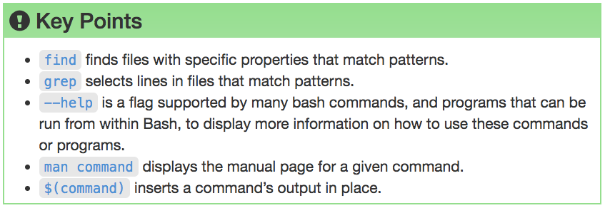

Slide 66
Research Computing Services
Unix Command Line
https://github.com/nuitrcs/intro-command-line-april-2019
Dusan Ramljak: dusan.ramljak@northwestern.edu
Christina Maimone: christina.maimone@northwestern.edu
Slides borrowed from Janna Nugent,
Alper Kinaci, Christina Maimone

